Slide 1
Biodiversity in
National Parks
A Data Analysis Portfolio Project
By:
Aghogho Isiakpere

Slide 2
INTRODUCTION
This project is about biodiversity in national parks and has data from the National Parks Service about endangered species in different parks. It will analyze biodiversity data from the National Parks Service, particularly around various species observed in different national park locations. This project will scope, analyze, prepare, plot data, and seek to explain the findings from the analysis.

Slide 3
This project will perform a biodiversity analysis for the National
Parks Service. Some of the goals of this project includes:
To perform some analysis on the conservation statuses of these species and investigate if there are any patterns or themes to the types of species that become endangered.
To ensure the survival of at-risk species, to maintain the level of biodiversity within their parks.
To understand characteristics about the species and their conservations status, and those species and their relationship to the national parks.
PROJECT GOALS

Slide 4
Here are a few questions to be discussed in this project:
What is the distribution of conservation status for species?
Are certain types of species more likely to be endangered?
Are the differences between species and their conservation status significant?
Which animal is most prevalent and what is their distribution amongst parks?
Which species were spotted the most at each park?

Slide 5
Data
Observations.csv
species_info.csv
observations.csv - holds recorded sightings of different species at several national parks for the past 7 days.
species_info.csv - contains data about different species and their conservation status

Slide 6
Data Description
Species_info.csv
Observations.csv
category - class of animal
scientific_name - the scientific name of each species
common_name - the common names of each species
conservation_status - each species’ current conservation status
scientific_name - the scientific name of each species
park_name - Park where species were found
observations - the number of times each species was observed at park
Species_df
Observations_df
species shape: (5824, 4)
category 7
scientific_name 5541
common_names 5504
conservation_status 4
observations shape: (23296, 3)
scientific_name 5541
park_name 4
observations 304

Slide 7
What is the distribution
of conservation status for species?
Total species rows: 5,824.
Conservation status counts: No Status: 5,633 species (96.72%) Species of Concern: 161 species (2.76%) Endangered: 16 species (0.27%) Threatened: 10 species (0.17%) In Recovery: 4 species (0.07%)
A bar chart of this distribution was generated.
Interpretation: The vast majority of species entries have no conservation status recorded in this dataset. This large missingness strongly affects any downstream inference about the frequency of statuses.

Slide 8
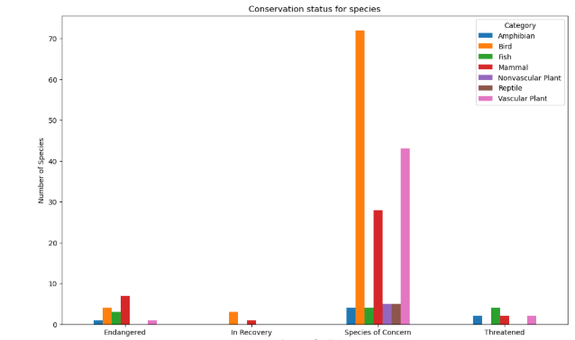

Slide 9
Are certain types of species
more likely to be endangered?
Proportions of Endangered by category were computed where applicable. Top proportions (if Endangered exists): e.g., Mammal and Birds had the highest endangered entries.

Slide 10
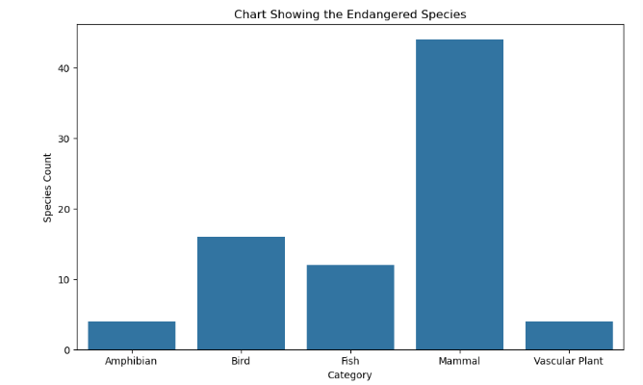

Slide 11
Are the differences between species and their conservation status significant?
I created a contingency table (species category × conservation_status_filled) ran a Chi-square test of independence on the contingency table: Test result: chi2 and p_value were computed. While mammals and Birds gave significant difference in conservation percentage, mammals and fish exhibited a statistically significant difference as well as fish and bird.

Slide 12
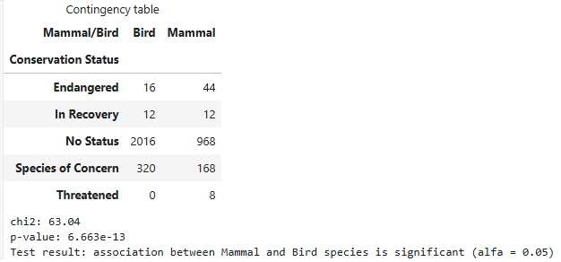

Slide 13
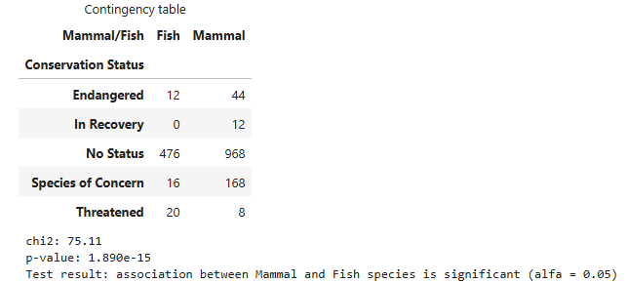

Slide 14
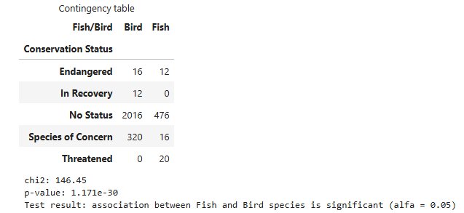

Slide 15
Which animal is most prevalent and what is their distribution amongst parks?
Most observed species (common name):
I extracted the top species name from the observations dataset. I created a bar chart showing that species' observations across parks (top parks displayed). The study found that bats occurred the most number of times and they were most likely to be found in Yellowstone National Park.

Slide 16
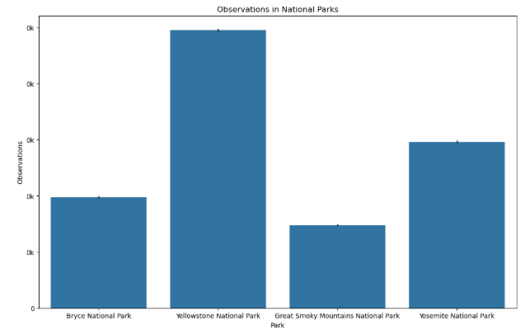

Slide 17
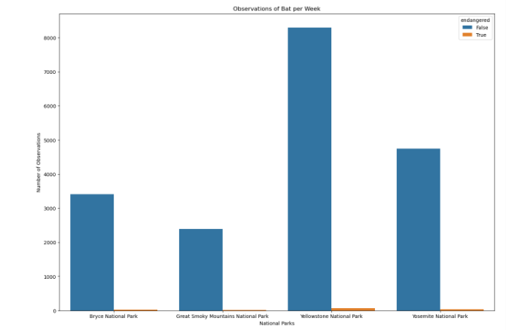

Slide 18
Species spotted the most at each park?
For each park, I found the species with the maximum total observations .

Slide 19
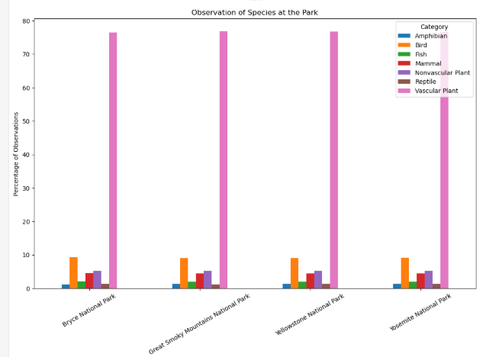

Slide 20
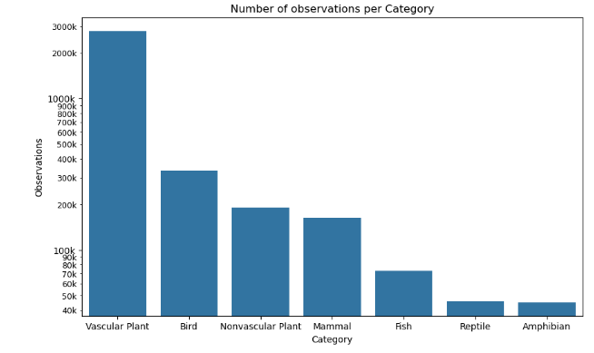

Slide 21
Recommendation
Step 1
Massive missingness in conservation_status (96.7% Not Listed). This will bias conclusions. I recommend enriching the dataset with authoritative conservation status sources (IUCN Red List, national lists) for missing species to have robust results
Step 2
Species name matching: I used scientific_name as the join key.
Re-run the association test excluding 'No status' and present adjusted results.
Step 3
Time-trend analyses if you have temporal data: This dataset only included observations from the last 7 days which prohibits analyze changes over time. It is recommended to see how the conservation status for various species changes over time.

Slide 22
The project was able to make several data analysis and visualizations about the various species in four of the National Parks. I was also able to answer some of the questions posed in the goals of the project as shown in the above slides with their respective charts.
CONCLUSION

Slide 23
Thank you!

